Slide 1
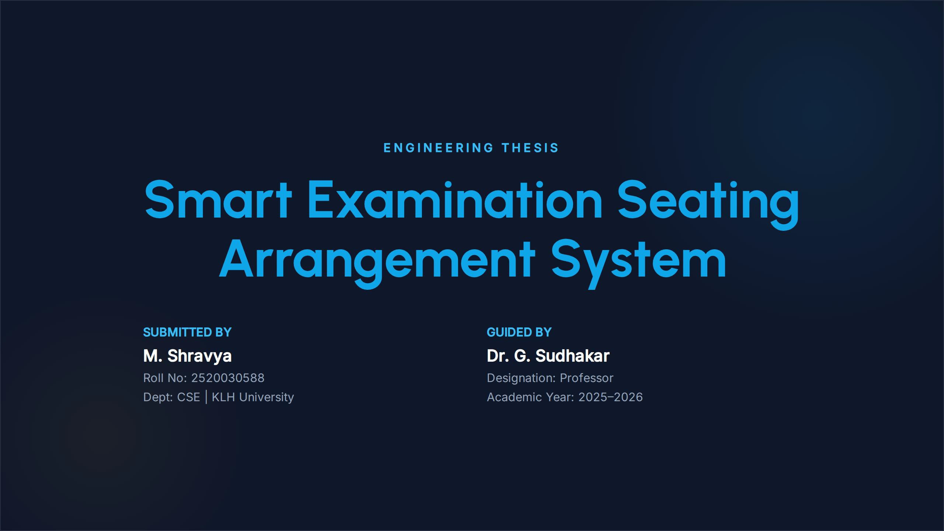
g.Keerthi
2520030416

Slide 2
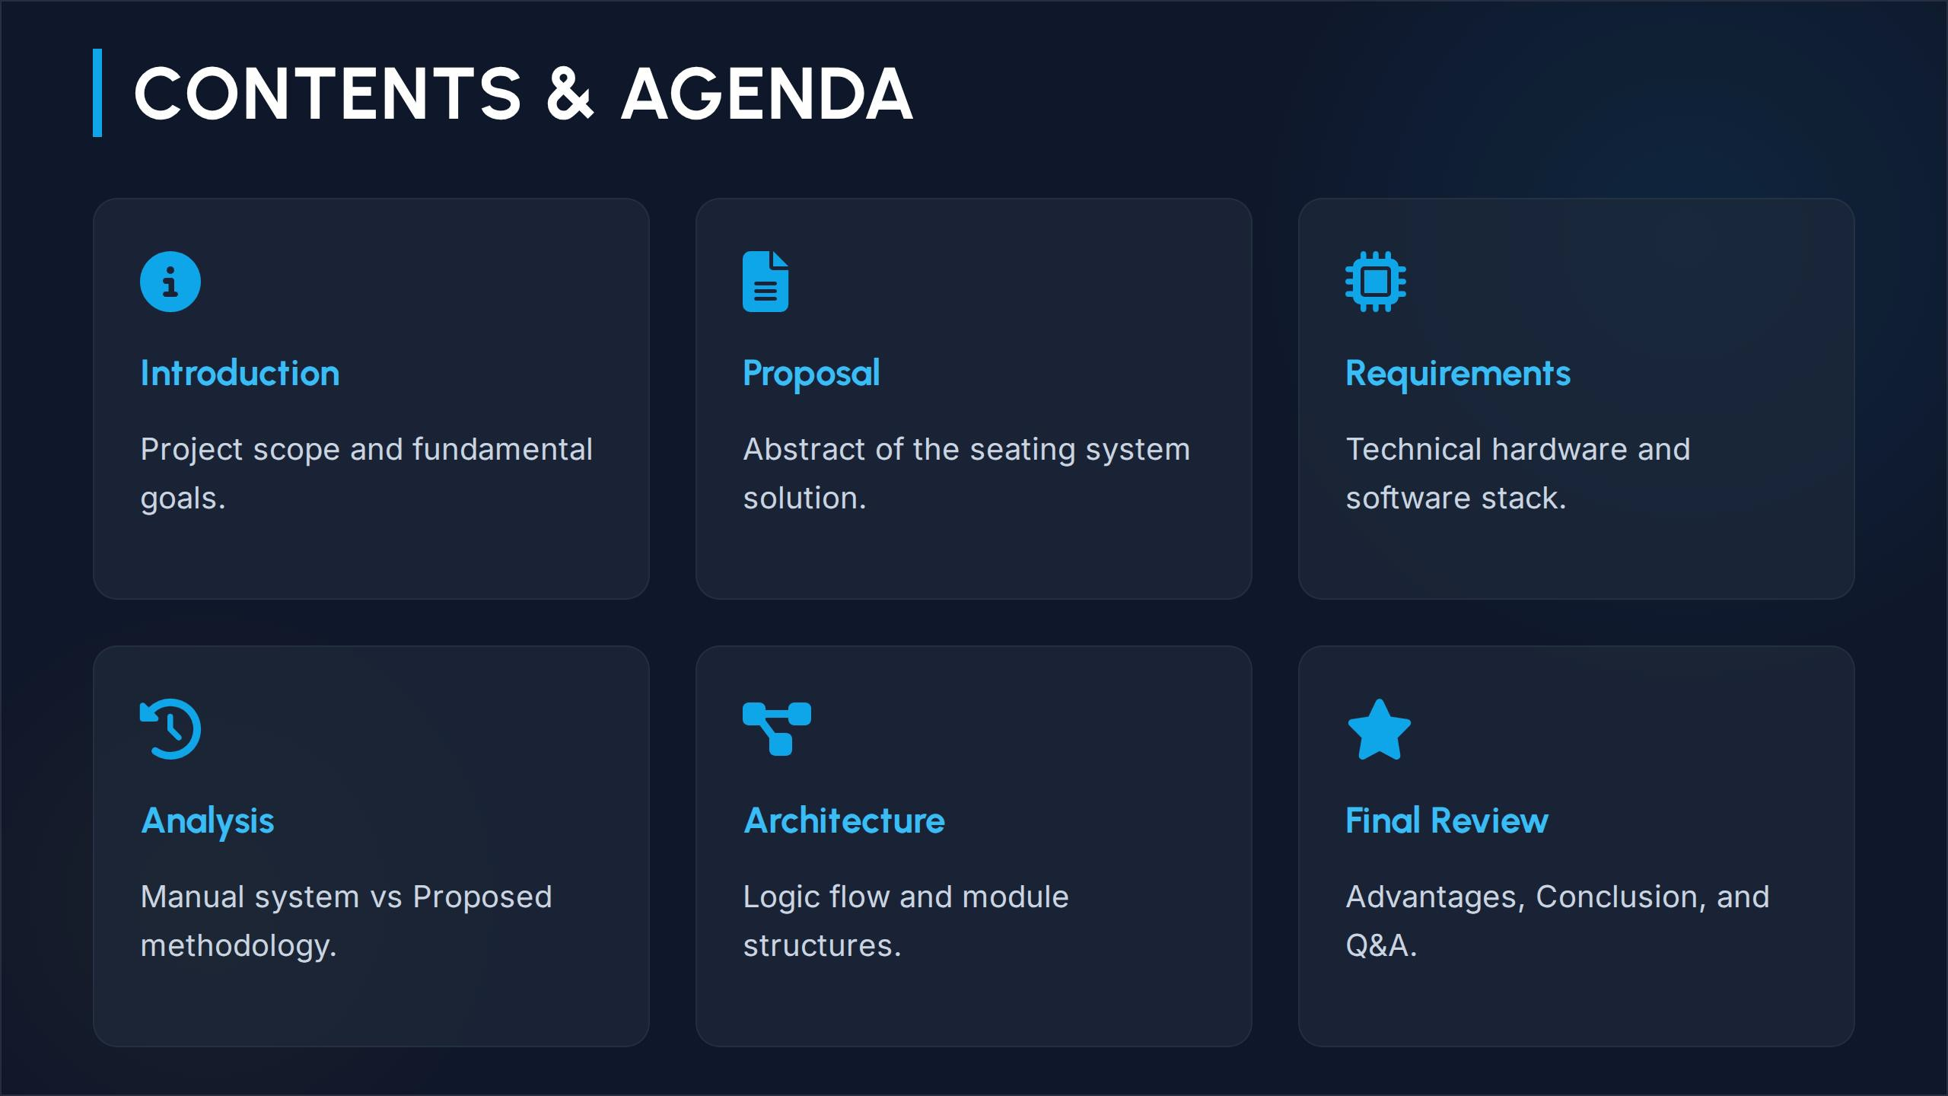

Slide 3
m 8 Print/Export.. a Share..
Saved v
Room
Classroom demo
Edit selected room
A
A
Clear
V
V
----..
e.. )
MA
"'4aVIS
tonuca
----J....
-J
G.11')'
H cchcock
J.1cqv1
Thurmon
-------------"-----------------==== wac.a�====::!c_• _
Front of the room t,&.

Slide 4
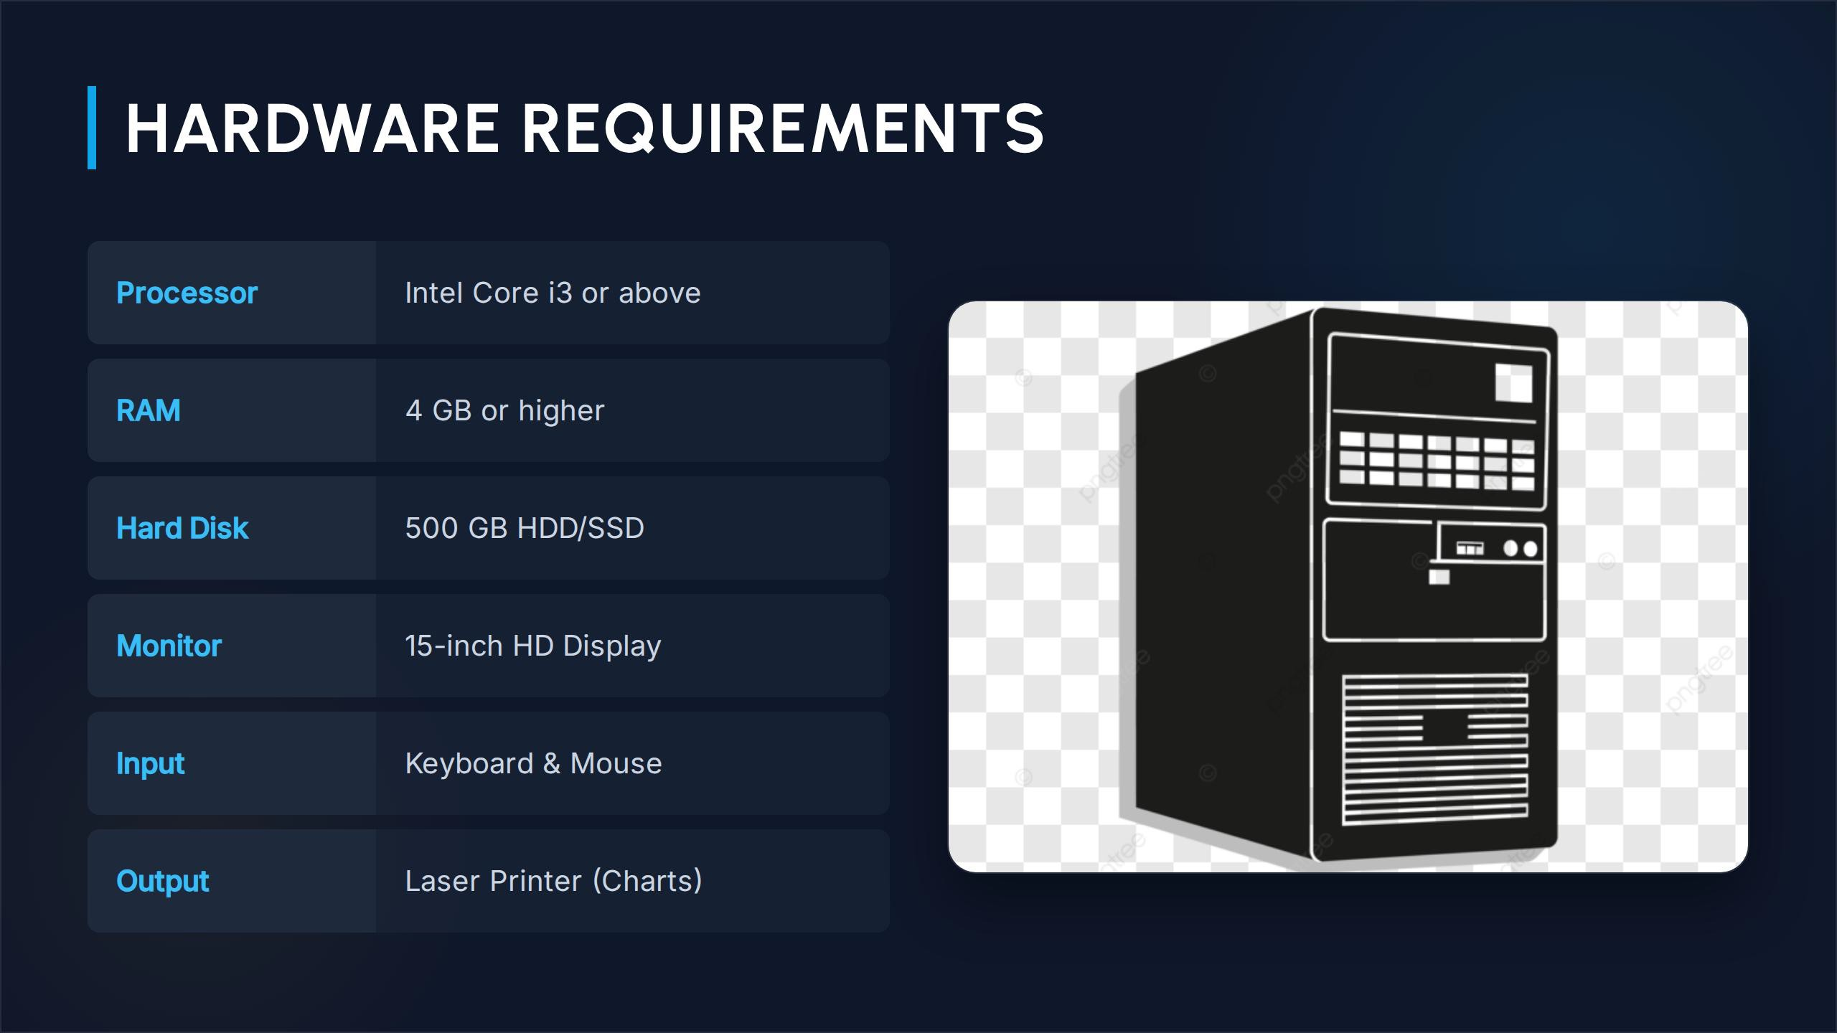

Slide 5
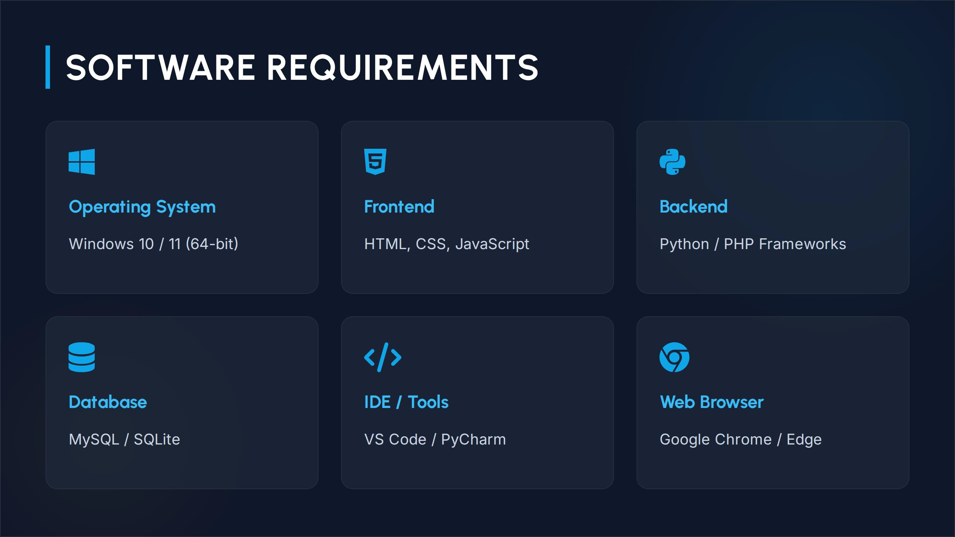

Slide 6
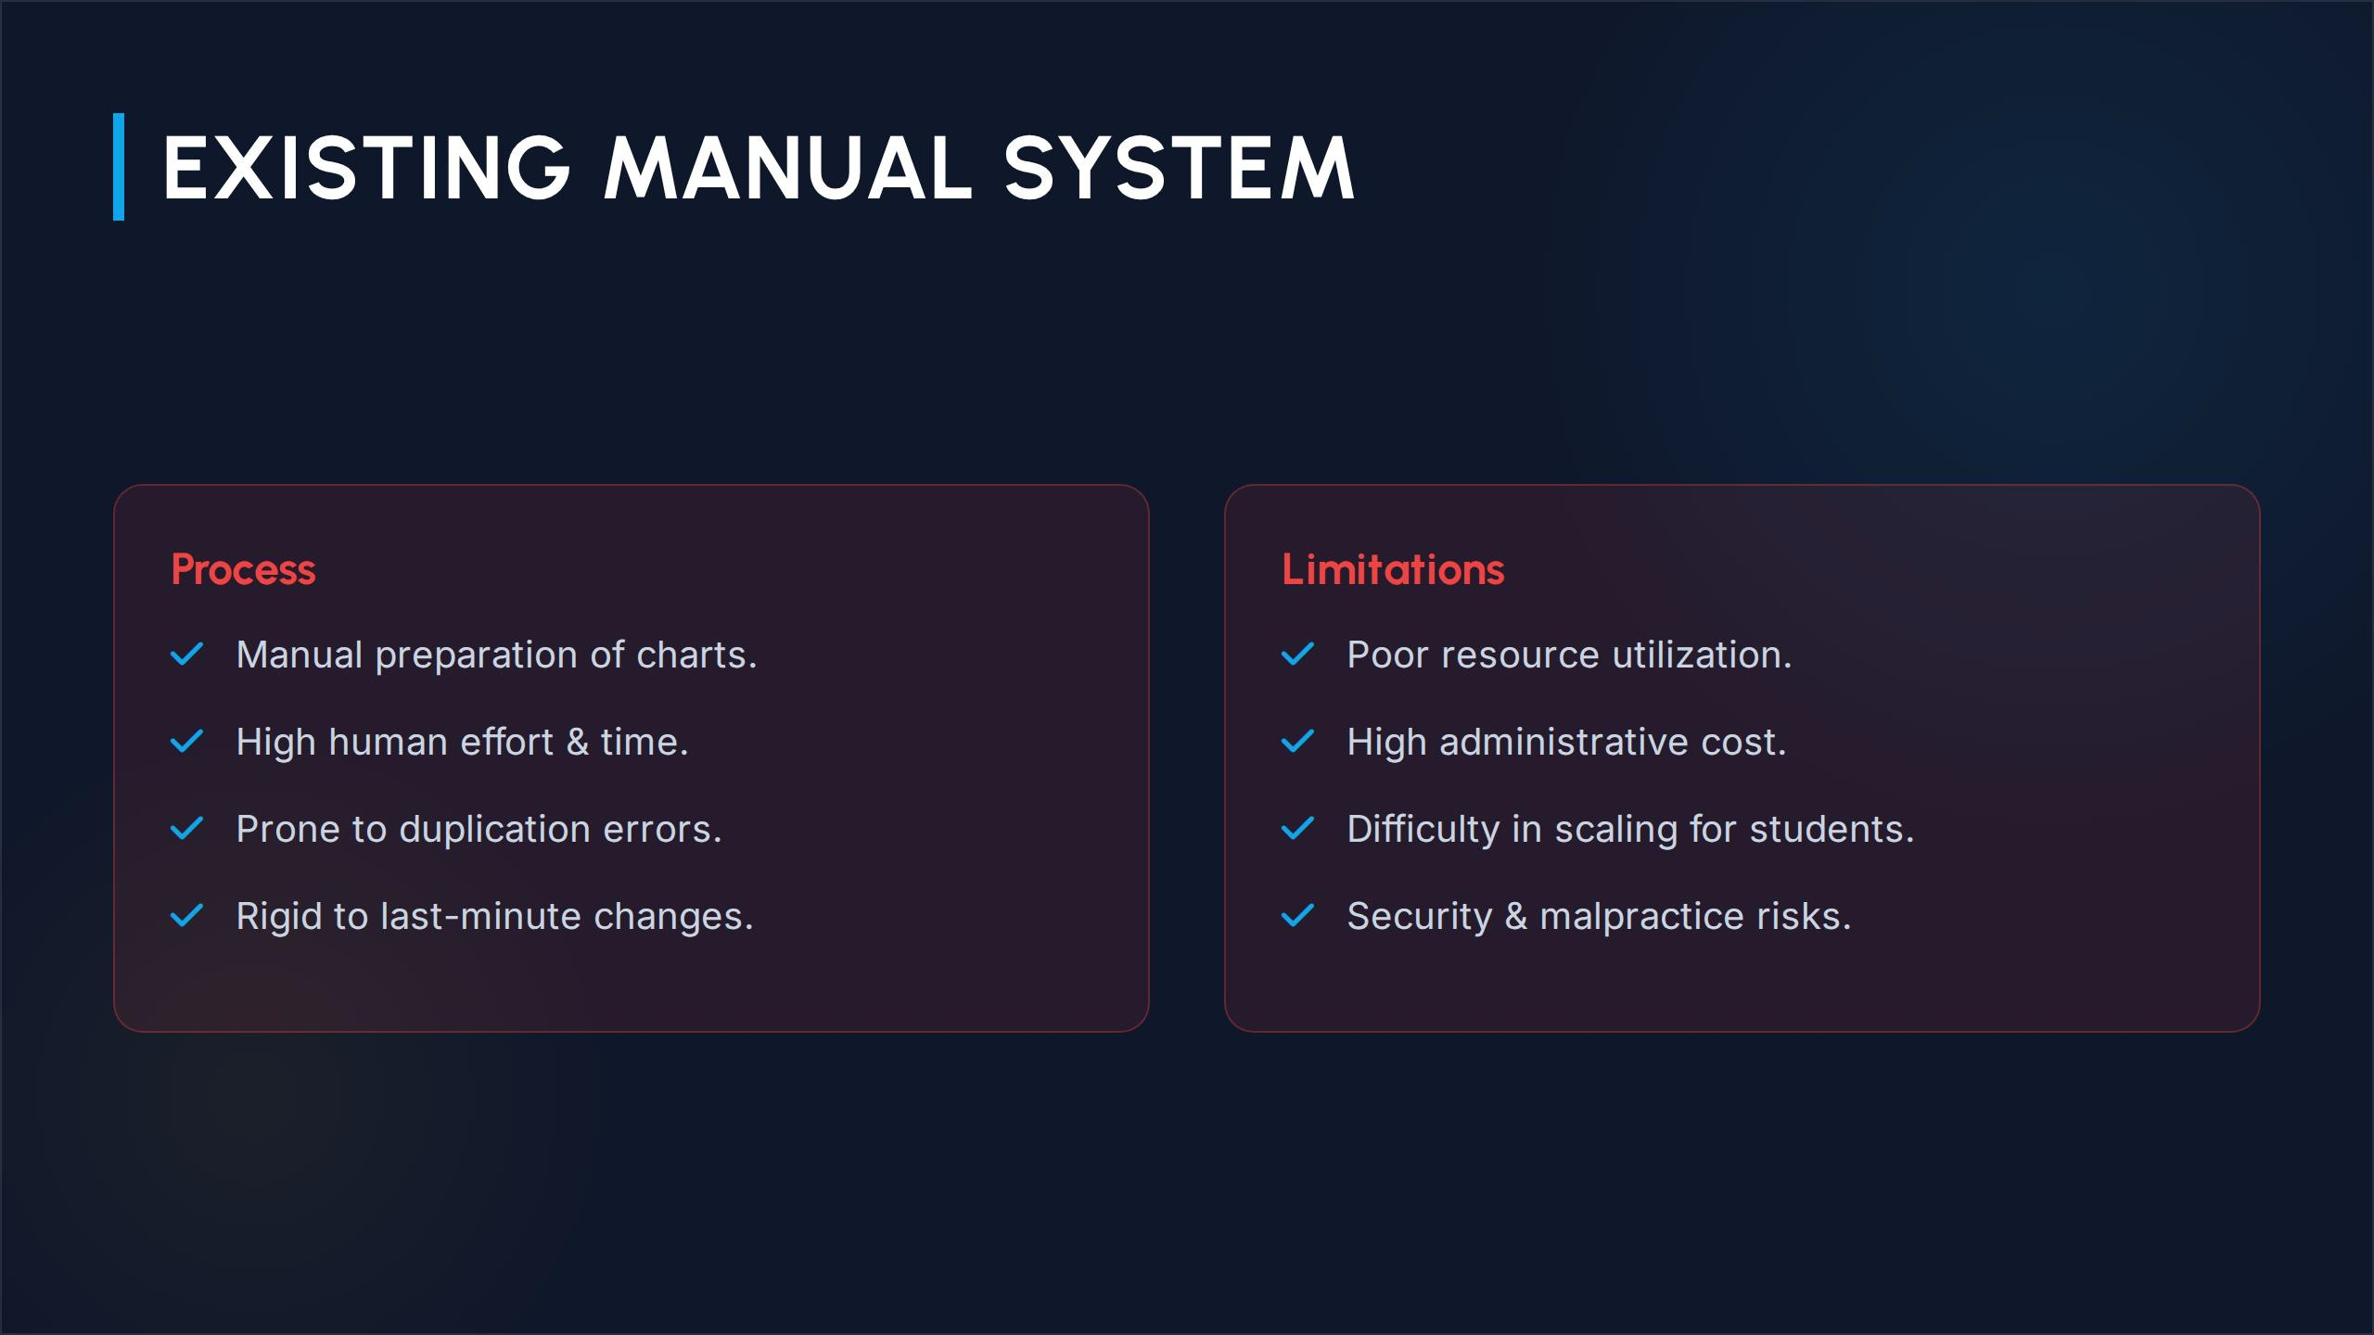

Slide 7
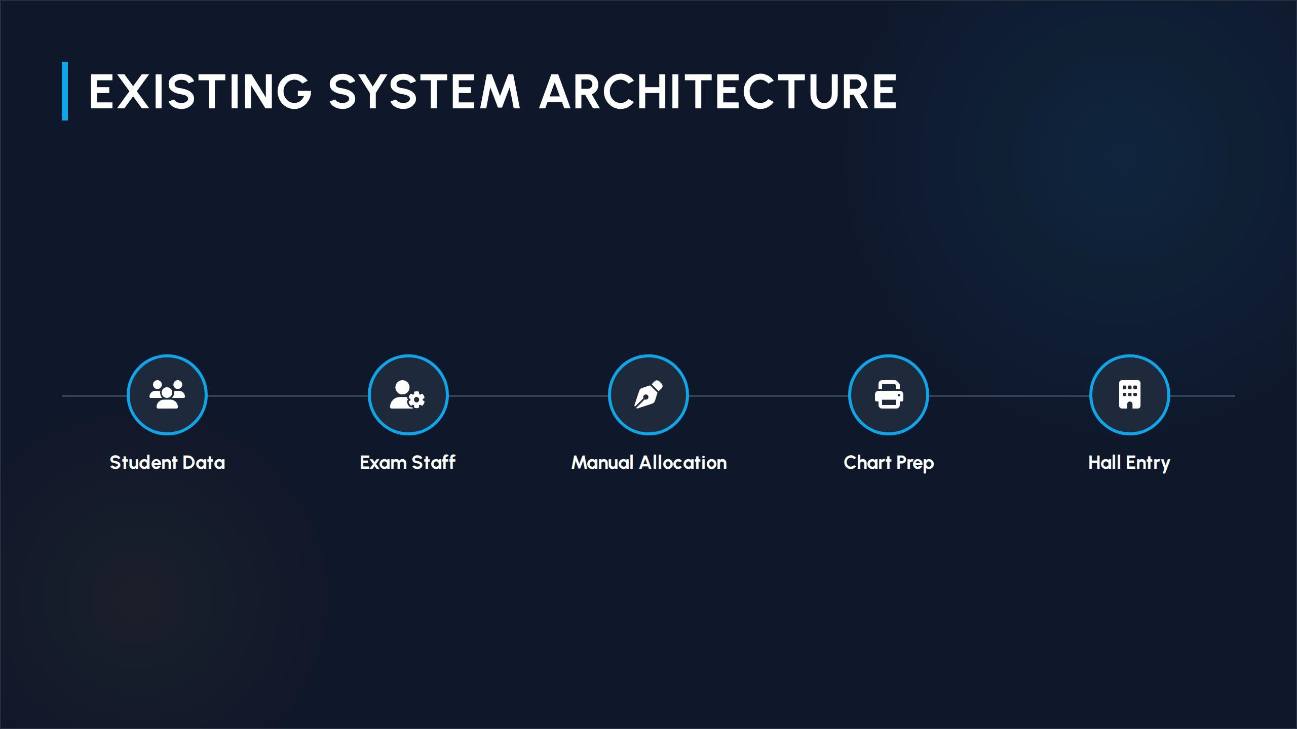

Slide 8
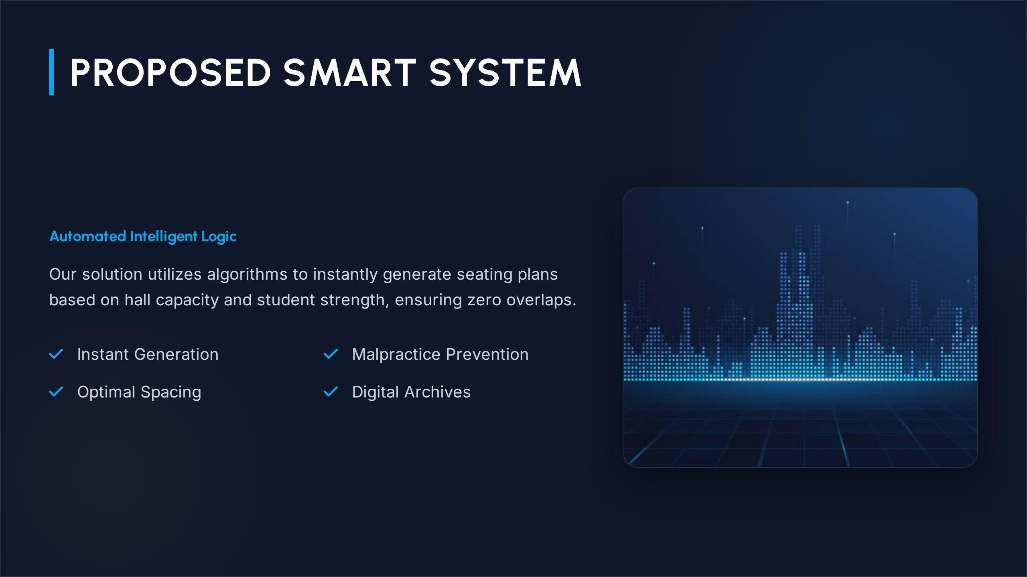

Slide 9
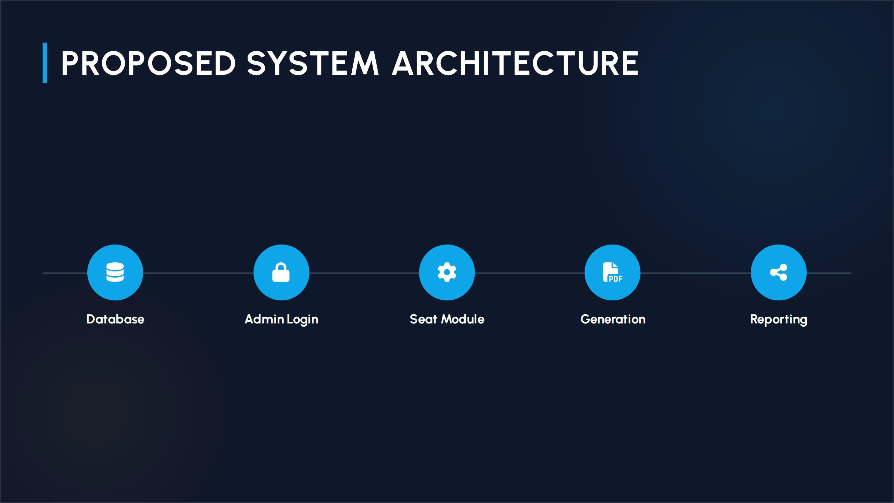

Slide 10
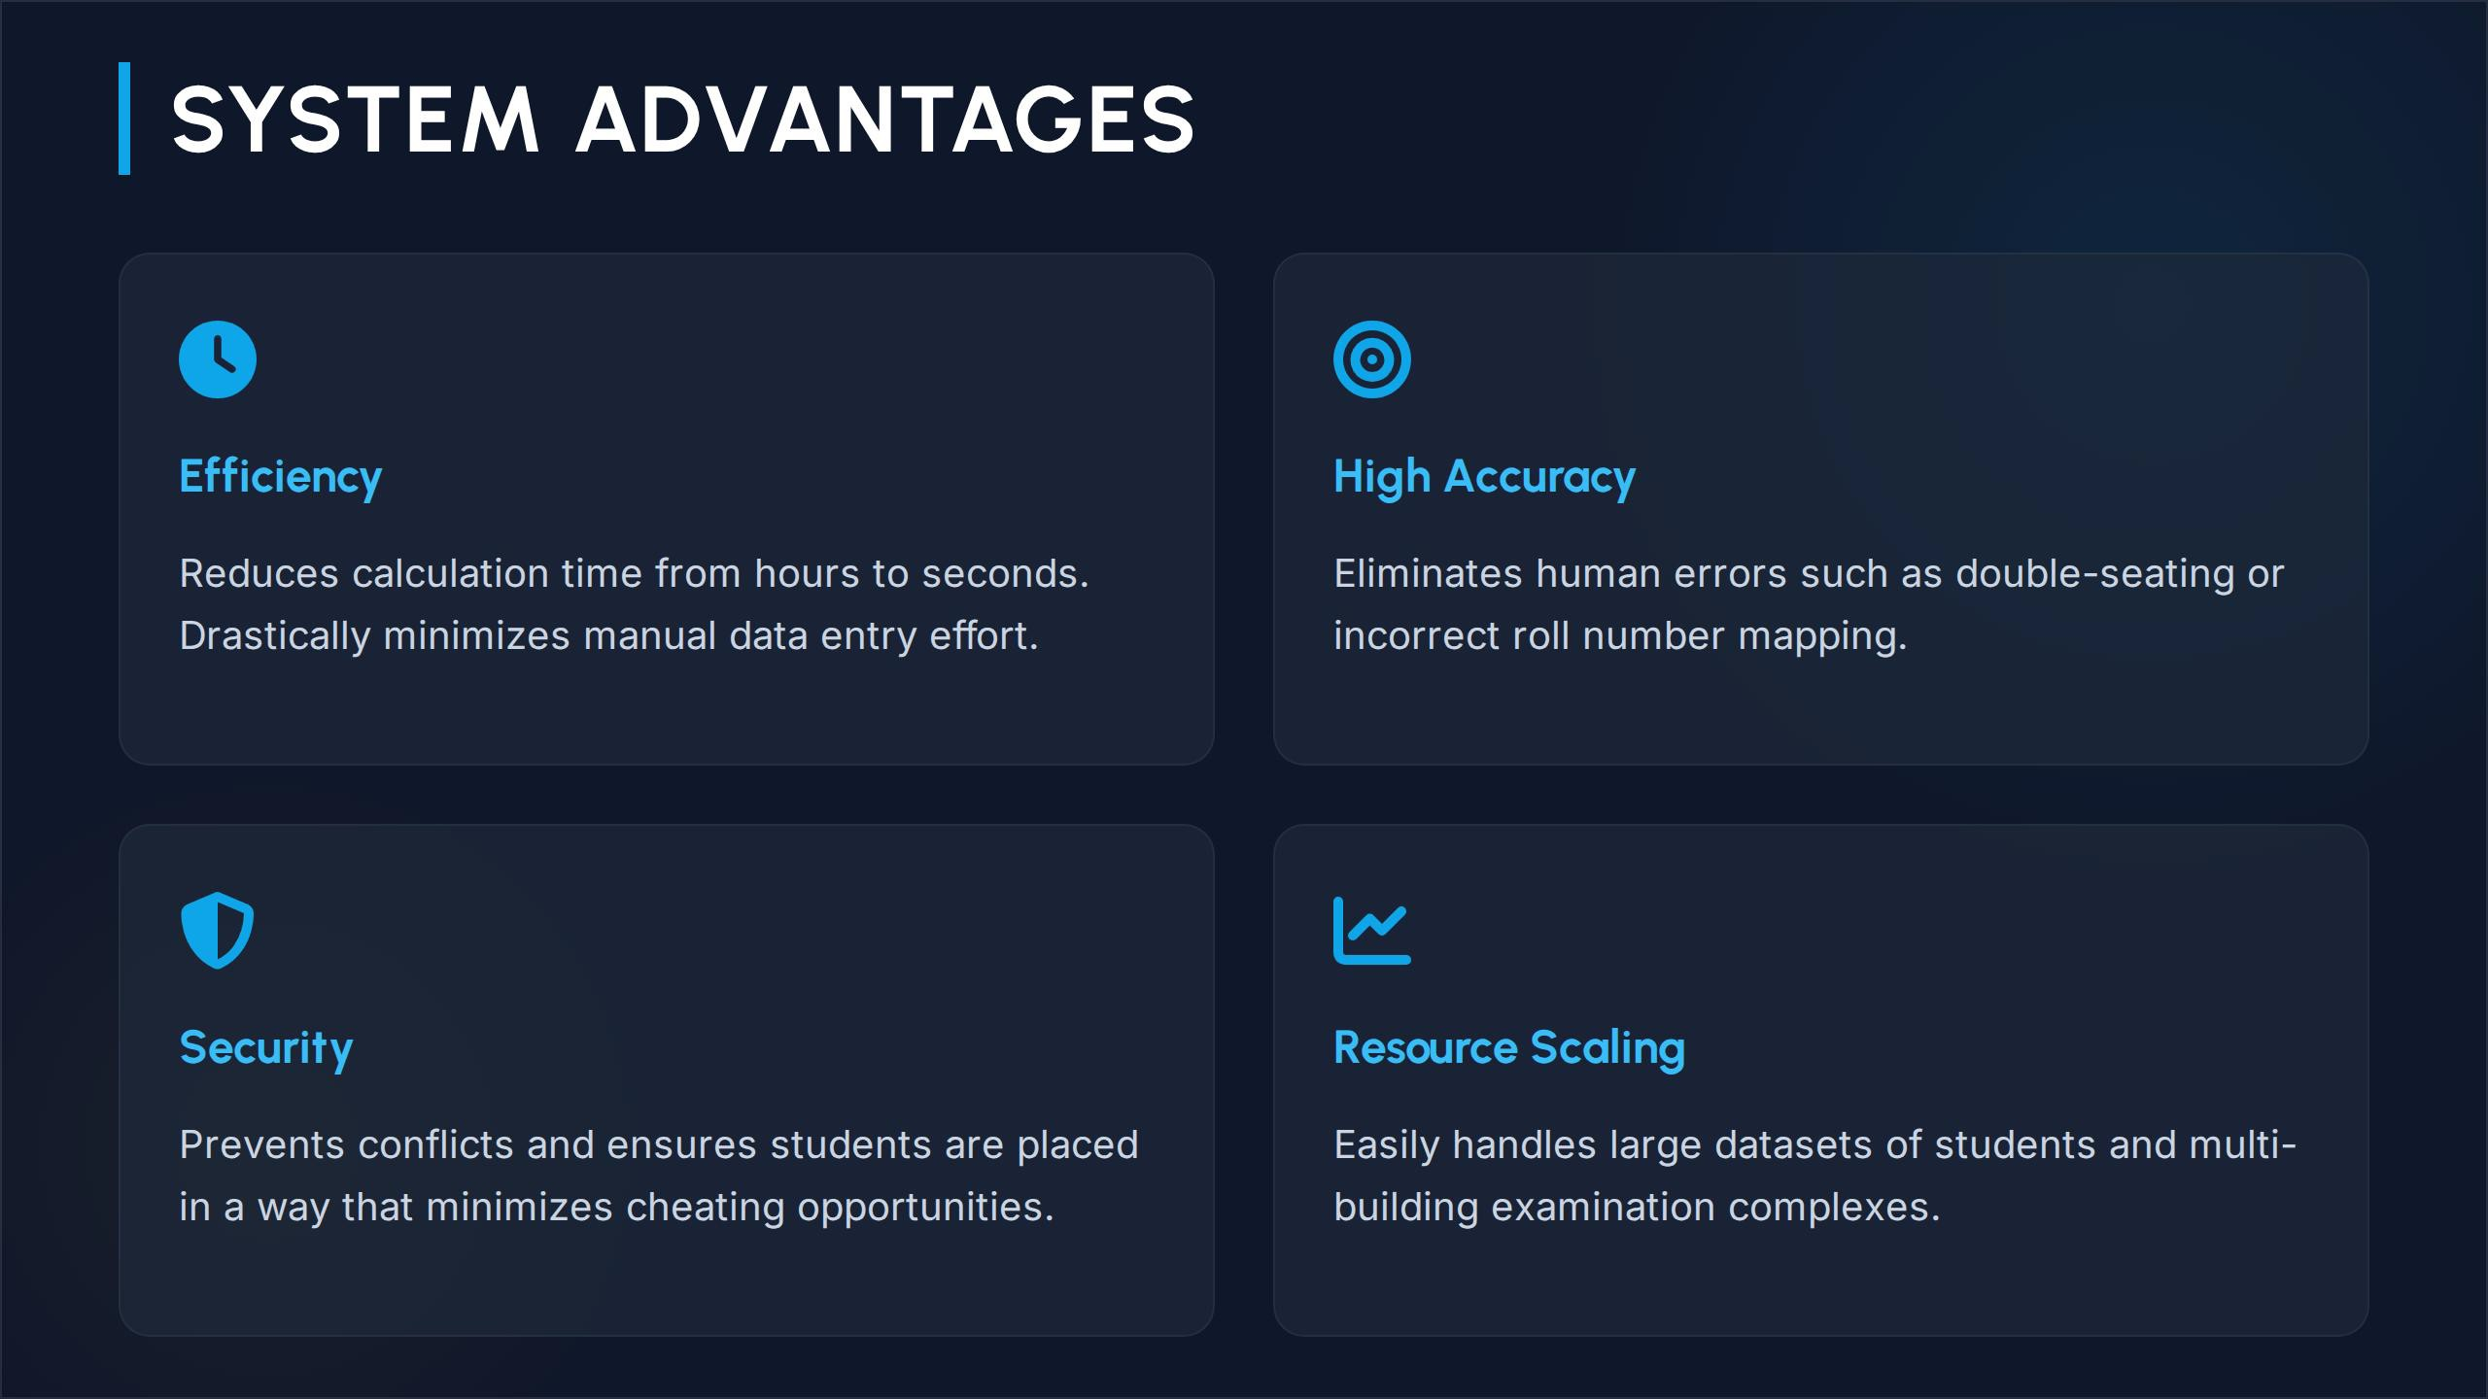

Slide 11
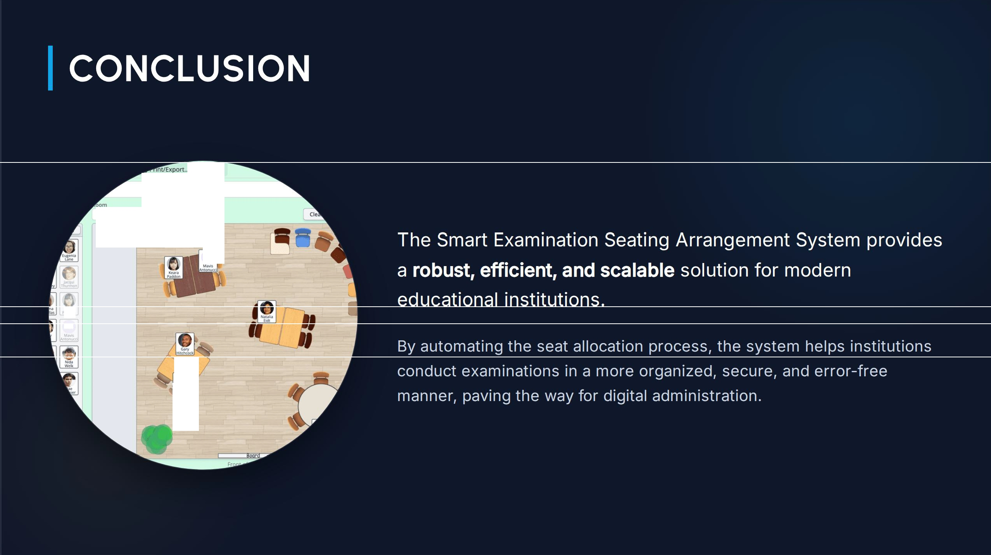
Q Share..
Classroom demo
Edit selected room
A
"
MA
.,.
ldon
"'1A
� I
J.Kqui
Tburm<>n

Slide 12


Slide 13
.., :

